Slide 1
UT-CAD Manager

Slide 2
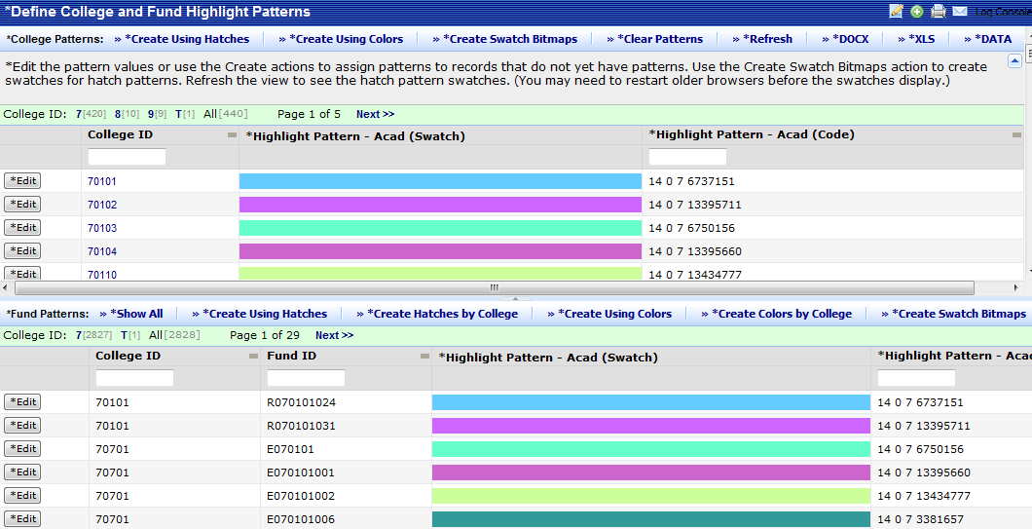
Define College and Fund Highlight Patterns
Define College and Fund Highlight Patterns
The Define College and Fund Highlight Patterns task is used to assign a highlight pattern to a college and. On the Process Navigator, click on the Space Inventory & Performance activity, and click on the UT-CAD Manager role or process and click on the Define College and Fund Highlight Patterns task. Click on the Edit button beside any category (college or fund) to manually change a single highlight pattern. To automatically generate a solid fill or hatch pattern for a college or fund, click on the Create Using Hatches or Create Using colors button. If your highlight is a solid fill, the system will display a sample swatch in the grid. If your highlight is a hatch pattern, generate a swatch as described in step 6.
3
3
2
3
3
2

Slide 3
Define College and Fund Highlight Patterns
Define College and Fund Highlight Patterns
To clear all highlight pattern values so that the system will generate values for all records, click on the Clear Patterns button. You may want to combine colors and hatch patterns to show a hierarchical relationship, with all records of the same owner having unique hatch patterns but using the same color. For example, all funds within the same college can have the same color, but each fund can have a unique hatch pattern. Click on the Create Hatches by College button. Then generate a swatch as described in step 6. Visually seeing your highlight patterns helps you to avoid assigning the same or very similar patterns to the different records. When you choose a solid color, the system immediately generates a swatch of this highlight and displays it in the grid. However, hatch patterns require that you explicitly generate the swatch.
4
5

Slide 4
Define College and Fund Highlight Patterns
Define College and Fund Highlight Patterns
To generate swatches for all hatch patterns that do not have bitmaps, click on the Create Swatch Bitmaps. Click on the Refresh button and the system displays the hatch patterns. (If you have an older browser, you may need to exit the view and then reload it in order for the hatch patterns to display.) To generate the view as a Word document, click on the DOCX button. To generate the view as an Excel document, click on the XLS button.
6
7
8
9
6

Slide 5
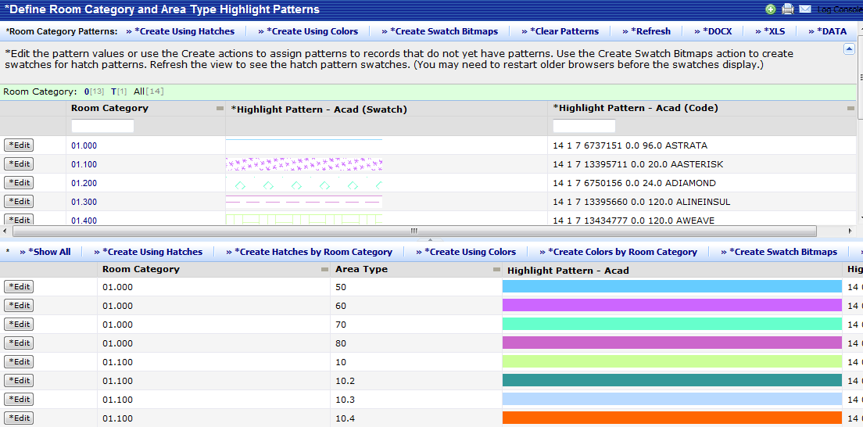
Define Room Category & Area Type Highlight Patterns
Define Room Category and Area Type Highlight Patterns
The Define Room Category and Area Type Highlight Patterns task is used to assign a highlight pattern to a room category and type. On the Process Navigator, click on the Space Inventory & Performance activity, and click on the UT-CAD Manager role or process and click on the Define Room Category and Area Type Highlight Patterns task. Click on the Edit button beside any category to manually change a single highlight pattern. To automatically generate a solid fill or hatch pattern, click on the Create Using Hatches or Create Using colors button. If your highlight is a solid fill, the system will display a sample swatch in the grid. If your highlight is a hatch pattern, generate a swatch as described in step 6.
3
3
2
3
3
2

Slide 6
Define Room Category & Area Type Highlight Patterns
Define Room Category and Area Type Highlight Patterns
To clear all highlight pattern values so that the system will generate values for all records by clicking on the Clear Patterns button. You may want to combine colors and hatch patterns to show a hierarchical relationship, with all records of the same owner having unique hatch patterns but using the same color. For example, all area types within the same room category can have the same color, but each area type can have a unique hatch pattern. Click on the Create Hatches by Room Category or Create Colors by Room Category button. Then generate a swatch as described in step 6.
4
5
5

Slide 7
Define Room Category & Area Type Highlight Patterns
Define Room Category and Area Type Highlight Patterns
Visually seeing your highlight patterns helps you to avoid assigning the same or very similar patterns to the different records. When you choose a solid color, the system immediately generates a swatch of this highlight and displays it in the grid. However, hatch patterns require that you explicitly generate the swatch. To generate swatches for all hatch patterns that do not have bitmaps, click on the Create Swatch Bitmaps. Click on the Refresh button and the system displays the hatch patterns. (If you have an older browser, you may need to exit the view and then reload it in order for the hatch patterns to display.) To generate the view as a Word document, click on the DOCX button. To generate the view as an Excel document, click on the XLS button.
6
7
8
9
6

Slide 8
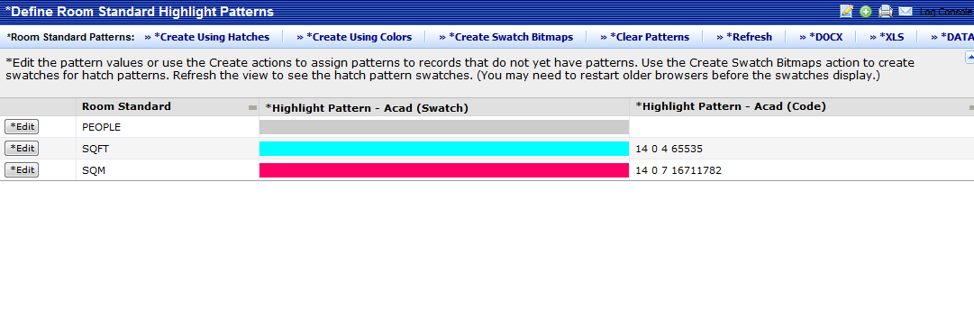
Define Room Standard Highlight Patterns
Define Room Standard Highlight Patterns
The Define Room Standard Highlight Patterns task is used to assign a highlight pattern to a room standard. On the Process Navigator, click on the Space Inventory & Performance activity, and click on the UT-CAD Manager role or process and click on the Define Room Standard Highlight Patterns task. Click on the Edit button beside any category to manually change a single highlight pattern. To automatically generate a solid fill or hatch pattern, click on the Create Using Hatches or Create Using colors button. If your highlight is a solid fill, the system will display a sample swatch in the grid. If your highlight is a hatch pattern, generate a swatch as described in step 5.
3
3
2

Slide 9
Define Room Standard Highlight Patterns
Define Room Standard Highlight Patterns
To clear all highlight pattern values so that the system will generate values for all records by clicking on the Clear Patterns button. Visually seeing your highlight patterns helps you to avoid assigning the same or very similar patterns to the different records. When you choose a solid color, the system immediately generates a swatch of this highlight and displays it in the grid. However, hatch patterns require that you explicitly generate the swatch. To generate swatches for all hatch patterns that do not have bitmaps, click on the Create Swatch Bitmaps.
5
4

Slide 10
Define Room Standard Highlight Patterns
Define Room Standard Highlight Patterns
Click on the Refresh button and the system displays the hatch patterns. (If you have an older browser, you may need to exit the view and then reload it in order for the hatch patterns to display.) To generate the view as a Word document, click on the DOCX button. To generate the view as an Excel document, click on the XLS button.
6
7
8

Slide 11
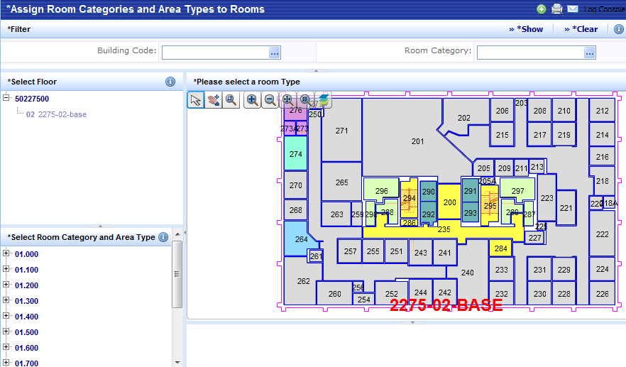
To Assign Categories & Area Types to Rooms
Assign Category & Area Types to Rooms
The Assign Category and Area Types to Rooms task is used to assign room categories and area types to rooms by locating the room on a floor plan and editing its data. On the Process Navigator, click on the Space Inventory & Performance activity, and click on the UT-CAD Manager role or process and click on the Assign Categories and Area Types to Rooms task. The system presents a filter console, drill-down tree for selecting the floor plan, and a panel for selecting the room category and room type. Select the floor whose rooms you wish to edit. Once you select the floor, the system presents the drawing in the right panel. The drawing's rooms are highlighted according to the colors of the room category and type records displayed under the lower left panel.
4
3

Slide 12
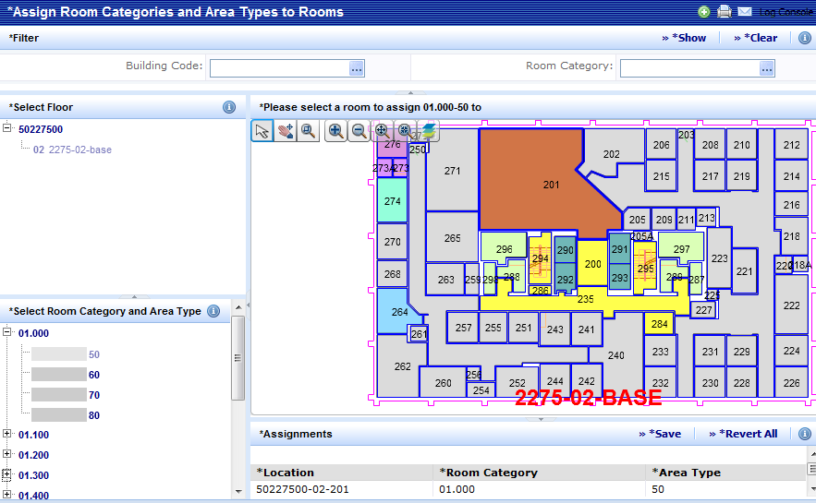
To Assign Categories & Types to Rooms
Assign Category & Types to Rooms
To assign a category and area type to a room, select the area type in the lower left panel. In the drawing, click on the room to which you want to assign. The system redisplays the room in the color associated with the selected value. In the lower right panel, Assignments, the program lists the assignments that you make with this task. Note: The room asset text is not updated until you actually save the change. Click on the Save button in the Assignments panel . The assignments are changed in the database and the labeling asset text is updated. To cancel all your assignments, click on the Revert All button. Hover over the room with your mouse and the room number and details are displayed.
6
5
8
9
7

Slide 13
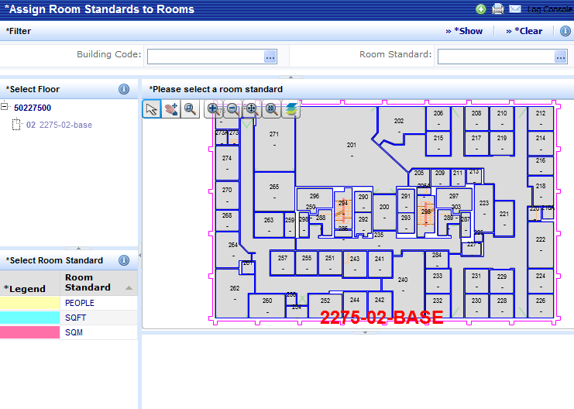
To Assign Room Standards to Rooms
Assign Room Standards to Rooms
The Assign Room Standards to Rooms task is used to assign room standards to rooms by locating the room on a floor plan and editing its data. On the Process Navigator, click on the Space Inventory & Performance activity, and click on the UT-CAD Manager role or process and click on the Assign Room Standards to Rooms task. The system presents a filter console, drill-down tree for selecting the floor plan, and a panel for selecting the room standard. Select the floor whose rooms you wish to edit. Once you select the floor, the system presents the drawing in the right pane. The drawing's rooms are highlighted according to the colors of the room standard records displayed under the lower left panel.
4
3

Slide 14
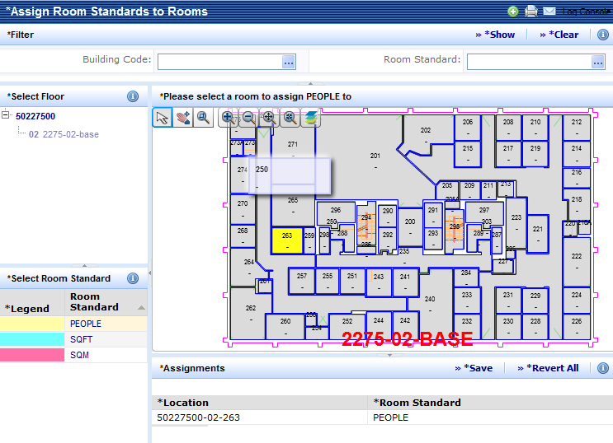
To Assign Room Standards to Rooms
Assign Room Standards to Rooms
To assign a room standard to a room, select the room standard in the lower left panel. In the drawing, click on the room to which you want to assign. The system redisplays the room in the color associated with the selected value. In the lower right panel, Assignments, the program lists the assignments that you make with this task. Note: The room asset text is not updated until you actually save the change. Click on the Save button in the Assignments panel The assignments are changed in the database and the labeling asset text is updated. To cancel all your assignments, click on the Revert All button. Hover over the room with your mouse and the room number and details are displayed.
6
5
8
9
7

Slide 15
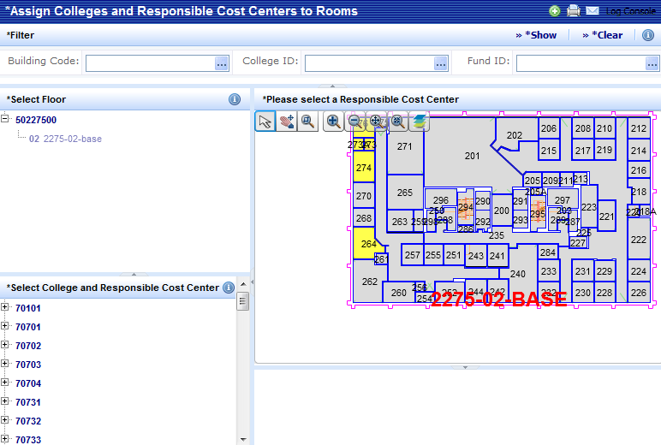
To Assign Colleges & Cost Centers to Rooms
Assign Colleges & Cost Centers to Rooms
The Assign Colleges and Cost Centers to Rooms task is used to assign colleges and responsible cost centers to rooms by locating the room on a floor plan and editing its data. On the Process Navigator, click on the Space Inventory & Performance activity, and click on the UT-CAD Manager role or process and click on the Assign Room Colleges and Cost Centers to Rooms task. The system presents a filter console, drill-down tree for selecting the floor plan, and a panel for selecting the college and cost center. Select the floor whose rooms you wish to edit. Once you select the floor, the system presents the drawing in the right pane. The drawing's rooms are highlighted according to the colors of the room standard records displayed under the lower left panel.
4
3

Slide 16
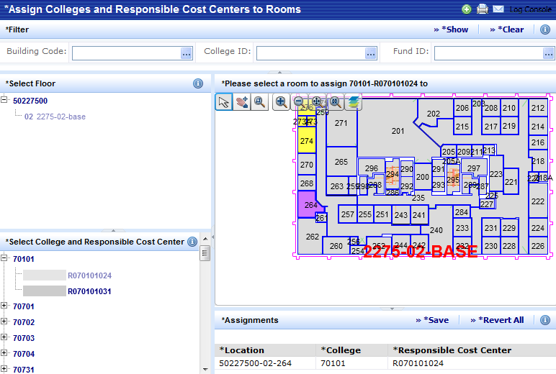
To Assign Colleges & Cost Centers to Rooms
Assign Colleges & Cost Centers to Rooms
To assign a college and responsible cost center to a room, select the responsible cost center in the lower left panel. In the drawing, click on the room to which you want to assign. The system redisplays the room in the color associated with the selected value. In the lower right panel, Assignments, the program lists the assignments that you make with this task. Note: The room asset text is not updated until you actually save the change. Click on the Save button in the Assignments panel The assignments are changed in the database and the labeling asset text is updated. To cancel all your assignments, click on the Revert All button. Hover over the room with your mouse and the room number and details are displayed.
6
5
8
9
7

Slide 17
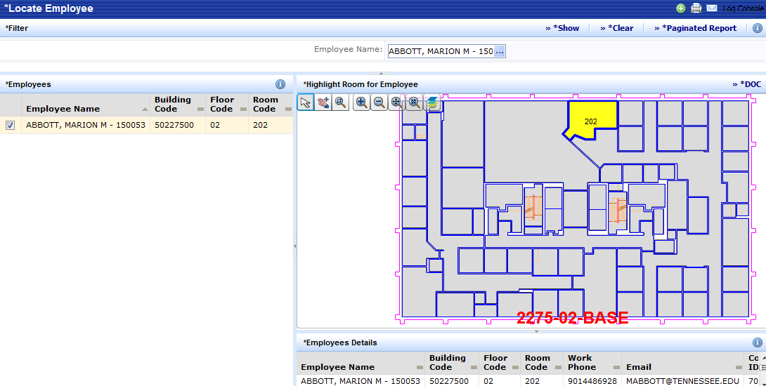
Locate Employee
Locate Employee
The Locate Employee task is used to view an employee’s location on a floor plan. On the Process Navigator, click on the Space Inventory & Performance activity, and click on the UT-CAD Manager role or process and click on the Locate Employee task. On the Filter console, select an employee by entering the Employee ID or click on the select value button to select an employee. Click on the Show button. The system displays the selected employee on the Employees panel. Click on the check box beside the employee ID. The employee information is displayed on the Employee Details panel.
3
2
4
5

Slide 18
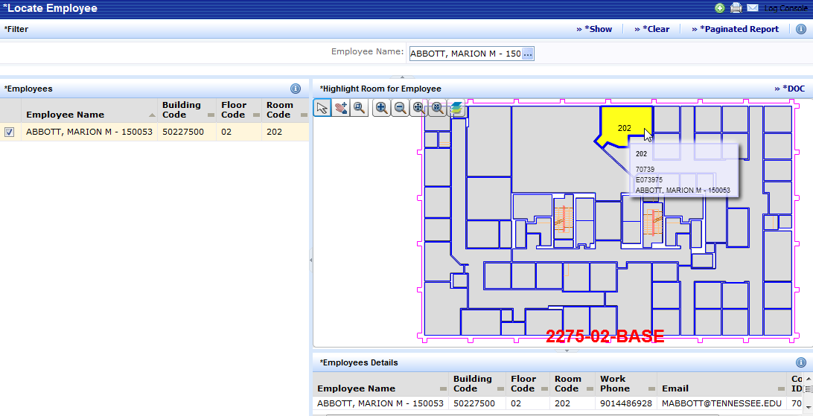
Locate Employee
Locate Employee
If the room that the employee occupies is represented in floor plan drawing, the system displays this drawing and highlights this room. Note: If the employee is not assigned to a room, the system alerts you. If the employee is assigned to a room that is not represented in a floor plan drawing, the system displays the room information in the bottom panel but does not display a drawing. Hover over the room with your mouse and the room number and details are displayed. To generate the view as a Word document, click on the DOC button.
8
6
7

Slide 19
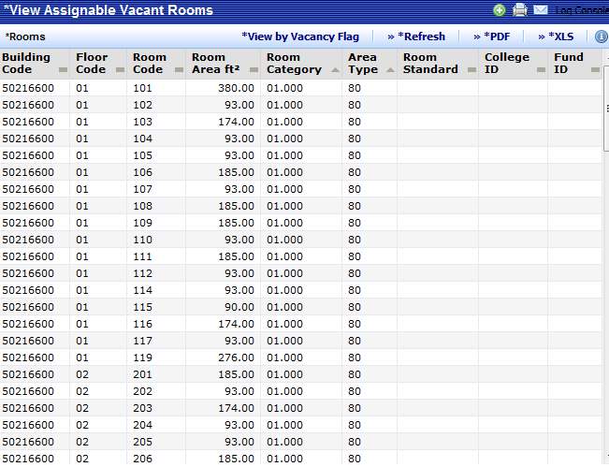
View Assignable Vacant Rooms
View Assignable Vacant Rooms
The View Assignable Vacant Rooms task is used to view a list of vacant rooms. On the Process Navigator, click on the Space Inventory & Performance activity, and click on the UT-CAD Manager role or process and click on the View Assignable Vacant Rooms task. The vacant rooms data is displayed on the Rooms panel. To view the data based on room vacancy flag, click on the View by Vacancy Flag button. To generate the view as a PDF document, click on the PDF button and a separate browser window opens and displays the panel's data in PDF format. To generate the view in Excel format, click on the XLS button.
3
4
5
2

Slide 20
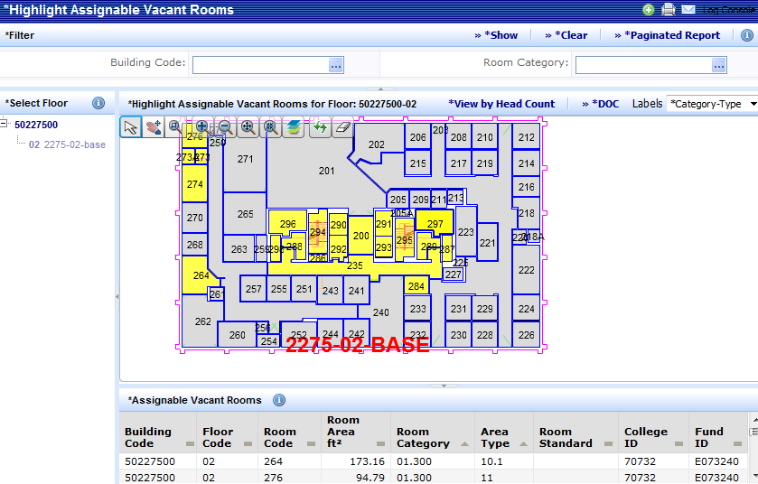
Highlight Assignable Vacant Rooms
Highlight Assignable Vacant Rooms
The Highlight Assignable Vacant Rooms task is used to view the location of vacant rooms on a floor plan drawing. On the Process Navigator, click on the Space Inventory & Performance activity, and click on the UT-CAD Manager role or process and click on the Highlight Assignable Vacant Rooms task. The system presents a filter console, drill-down tree for selecting the floor plan. Select the floor whose rooms you wish to view. Once you select the floor, the system presents the drawing in the right pane and highlights the floor’s vacant rooms.
2
4
3

Slide 21
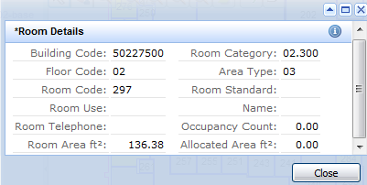
Highlight Assignable Vacant Rooms
Highlight Assignable Vacant Rooms
Key information for each vacant room is listed beneath the floor drawing on the Assignable Vacant Rooms panel. Click on any room on the drawing to access the dialog with further details about the room. To view the data based on headcount, click on the View by Headcount button. If you wish to see additional information about the rooms, such as a room's area or the type of room, select the appropriate attribute for the Labels option. You can hover over the room with your mouse to see the information. To generate the view as a Word document file, click on the DOC button.
7
9
8
6
5

Slide 22
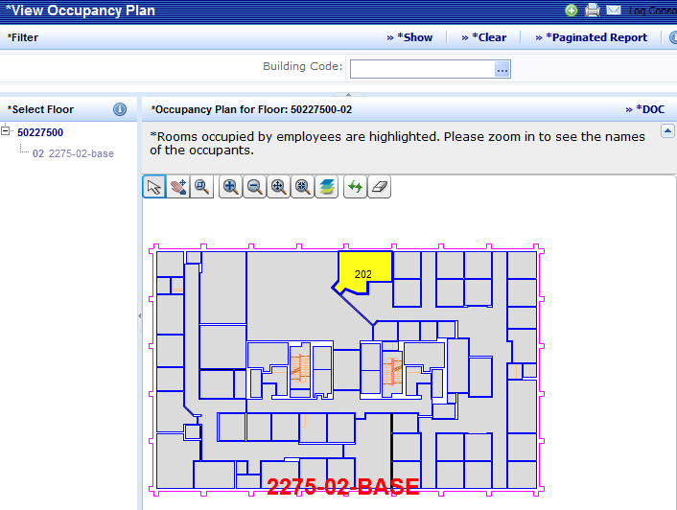
View Occupancy Plan
View Occupancy Plan
The View Occupancy Plan task is used to visually see each employee's location on a floor plan drawing. On the Process Navigator, click on the Space Inventory & Performance activity, and click on the UT-CAD Manager role or process and click on the View Occupancy Plan task. The system presents a filter console, drill-down tree for selecting the floor plan. Select the floor whose rooms you wish to view. Once you select the floor, the system presents the drawing in the right pane with the employee name and room number for every room that has an employee assignment. The system also highlights these rooms so that you can easily locate occupied rooms. If multiple employees are using this room, the system lists all employee names in the room.
2
4
3

Slide 23
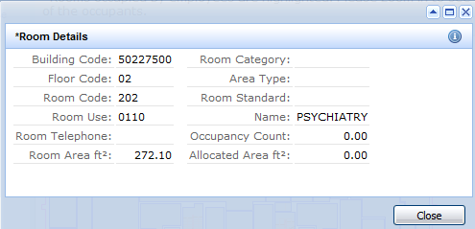
View Occupancy Plan
View Occupancy Plan
Click on any room on the drawing to access the dialog with further details about the room. Hover over the room with your mouse and the room number and details are displayed. To generate the view as a Word document file, click on the DOC button.
7
5

Slide 24
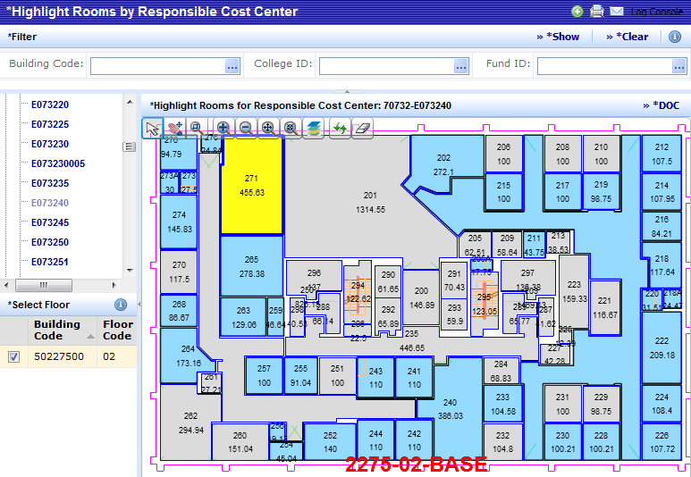
Highlight Rooms by Responsible Cost Center
Highlight Rooms by Responsible Cost Center
The Highlight Rooms by Responsible Cost Center task allows you to view your rooms on a floor plan by responsible cost center however it does not provide summary information, as does the Highlight Rooms by Responsible Cost Center per Floor task. On the Process Navigator, click on the Space Inventory & Performance activity, and click on the UT-CAD Manager role or process and then click on the Highlight Rooms by Responsible Cost Center task. On the Select Division and Department panel, drill down to choose the college and responsible cost center for which you want to see drawings by clicking on the plus sign.
2

Slide 25
Highlight Rooms by Responsible Cost Center
Highlight Rooms by Responsible Cost Center
You may also use the Filter Console to restrict the Select Floor panel to show only floors of a certain building or that contain rooms of a certain college or responsible cost center. Specify the building and/or college and responsible cost enter and click on the Show button. On the Select Division and Department panel, click on a responsible cost center and the drawing is presented with rooms highlighted according to their departmental or cost center assignment. If the cost center is represented with rooms on floor plan drawings, the floors are displayed on the Select Floor panel.
3
4
5

Slide 26
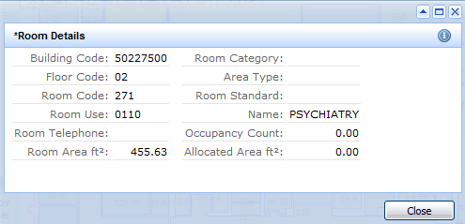
Highlight Rooms by Responsible Cost Center
Highlight Rooms by Responsible Cost Center
On the Select Floor panel, click on the check box beside a building code. The floor’s drawing is presented to the right and highlights the rooms of the specified cost center, according to the color associated with this cost center. Click on any room to access a dialog box with further details about the room. Hover over the room with your mouse and the room number and details are displayed. To generate the view as a Word document file, click on the DOC button.
9
7
6

Slide 27
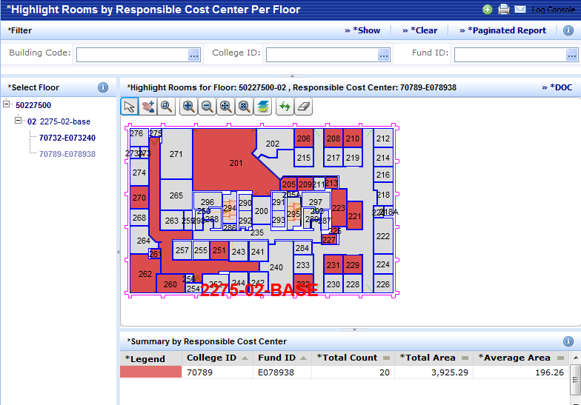
Highlight Rooms by Responsible Cost Center per Floor
Highlight Rooms by Responsible Cost Center per Floor
When analyzing departmental or cost center use of space, you will often want a graphical representation of how a floor is divided into rooms. The Highlight Rooms by Responsible Cost Center per Floor task allows you to view your rooms on a floor plan by responsible cost center. On the Process Navigator, click on the Space Inventory & Performance activity, and click on the UT-CAD Manager role or process and then click on the Highlight Rooms by Responsible Cost Center per Floor task. On the Select Floor panel, drill down to choose the building and floor for which you want to see drawings by clicking on the plus sign.
2

Slide 28
Highlight Rooms by Responsible Cost Center per Floor
Highlight Rooms by Responsible Cost Center per Floor
You may also use the Filter Console to restrict the Select Floor panel to show only floors of a certain building or that contain rooms of a certain college or responsible cost center. Specify the building and/or college and responsible cost center and click on the Show button. On the Select Floor panel, click on a floor and the drawing is presented with rooms highlighted according to their departmental or cost center assignment. The departmental or cost center data displayed on the Summary by Responsible Cost Center panel indicates the responsible cost center that each color represents. If you further drill down to select a responsible cost center, the drawing will highlight the rooms of the selected cost center, and present only data for this cost center on the Summary by Responsible Cost Center panel.
3
4
6
7
5

Slide 29
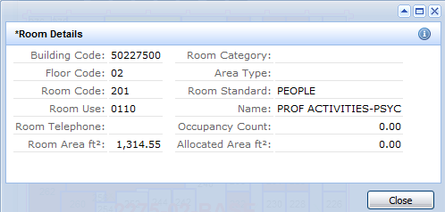
Highlight Rooms by Responsible Cost Center per Floor
Highlight Rooms by Responsible Cost Center per Floor
Click on any room to access a dialog box with further details about the room. Hover over the room with your mouse and the room number and details are displayed. To generate the view as a Word document file, click on the DOC button. Note: For each responsible cost center that has rooms on the floor, the report shows the average area, the total room area, and the number of rooms of the selected responsible cost center. Additionally, for the entire floor, the report displays the total number of rooms and the total room area.
9
7

Slide 30
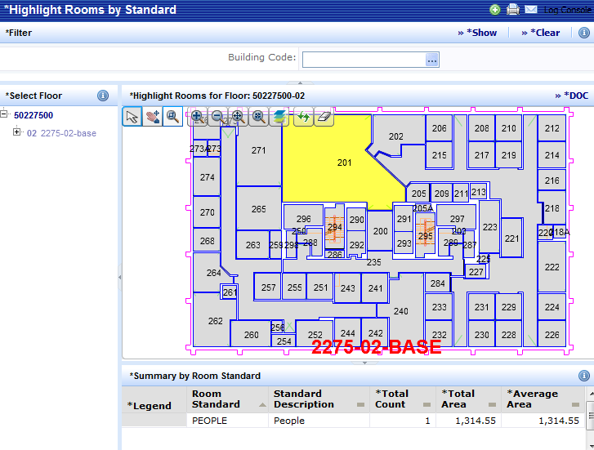
Highlight Rooms by Standard
Highlight Rooms by Standard
The Highlight Rooms by Standard task allows you to view your rooms on a floor plan by room standard. On the Process Navigator, click on the Space Inventory & Performance activity, and click on the UT-CAD Manager role or process and then click on the Highlight Rooms by Standard task. On the Select Floor panel, drill down to choose the building and floor for which you want to see drawings by clicking on the plus sign. You may also use the Filter Console to restrict the Select Floor panel to show only floors of a certain building. Specify the building and click on the Show button. On the Select Floor panel, click on a floor and the drawing is presented with rooms highlighted according to their room standard assignment.
3
2
4

Slide 31
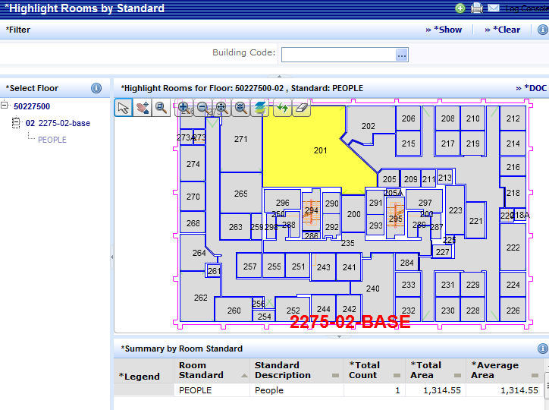
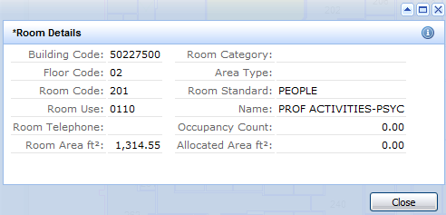
Highlight Rooms by Standard
Highlight Rooms by Standard
The room standard data displayed on the Summary by Room Standard panel indicates the room standard that each color represents. If you further drill down to select a room standard, the drawing will highlight the rooms of the selected room standard, and present only data for this room standard on the Summary by Room Standard panel. Click on any room to access a dialog box with further details about the room. Hover over the room with your mouse and the room number and details are displayed. To generate the view as a Word document file, click on the DOC button.
9
6
7
5

Slide 32
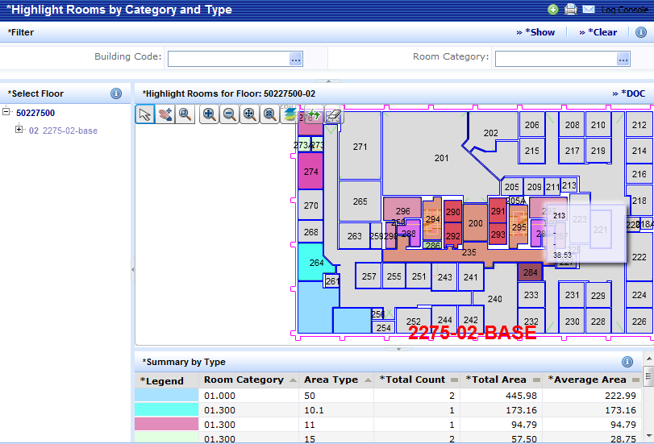
Highlight Rooms by Category and Area Type
Highlight Rooms by Category and Area Type
The Highlight Rooms by Category and Type task allows you to view your rooms on a floor plan by room category and room type. On the Process Navigator, click on the Space Inventory & Performance activity, and click on the UT-CAD Manager role or process and then click on the Highlight Rooms by Category and Type task. On the Select Floor panel, drill down to choose the building and floor for which you want to see drawings by clicking on the plus sign. You may also use the Filter Console to restrict the Select Floor panel to show only floors of a certain building or room category. Specify the building and/or room category and click on the Show button. On the Select Floor panel, click on a floor and the drawing is presented with rooms highlighted according to their room category and area type assignment.
3
4
2

Slide 33
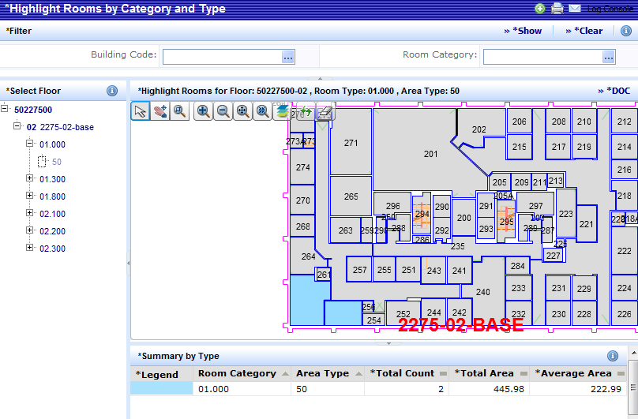
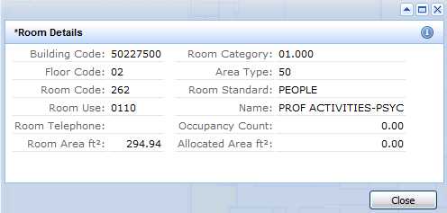
Highlight Rooms by Category and Area Type
Highlight Rooms by Category and Area Type
The room category and area type data displayed on the Summary by Type panel indicates the room category that each color represents. If you further drill down to select a room category or a area type, the drawing will highlight the rooms of the selected category or area type, and present only data for this category and area type on the Summary by Type panel. Click on any room to access a dialog box with further details about the room. Hover over the room with your mouse and the room number and details are displayed. To generate the view as a Word document file, click on the DOC button.
9
6
7
5

Slide 34
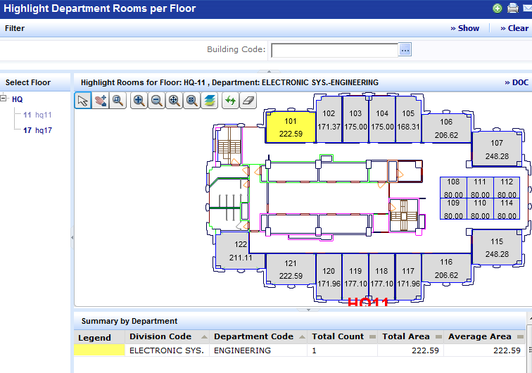
Highlight Responsible Cost Center Rooms per Floor
Highlight Responsible Cost Center Rooms per Floor
The Highlight Responsible Cost Center Rooms per floor task is used to highlight rooms on a floor plan drawing according to their responsible cost center assignment. On the Process Navigator, click on the Space Inventory & Performance activity, and click on the UT-CAD Manager role or process and click on the Highlight Responsible Cost Center Rooms task. The system presents a filter console, drill-down tree for selecting the floor plan. Select the floor whose rooms you wish to view. Once you select the floor, the system presents the drawing in the right pane and highlights rooms according to their responsible cost center assignment. The departmental or cost center data displayed on the Summary by Responsible Cost Center panel indicates the responsible cost center that each color represents.
3
4
5

Slide 35
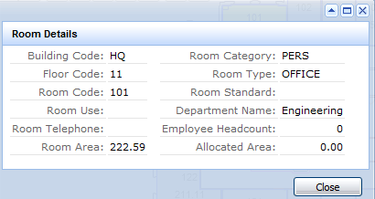
Highlight Responsible Cost Center Rooms per Floor
Highlight Responsible Cost Center Rooms per Floor
Click on any room on the drawing to access the dialog with further details about the room. Hover over the room with your mouse and the room number and details are displayed. To generate the view as a Word document file, click on the DOC button.
8
6

